Slide 1
Association Rules Mining

Slide 2
What is Association Mining?
The process of finding frequent patterns, associations, correlations, or causal structures among sets of items or objects in transaction databases, relational databases, or other information repositories.
Applications
Basket data analysis
Cross-selling marketing
Catalog design

Slide 3
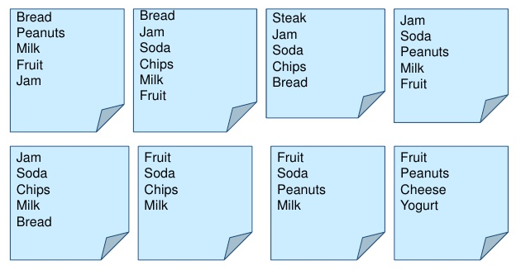
Examples of Market-Basket Transactions

Slide 4
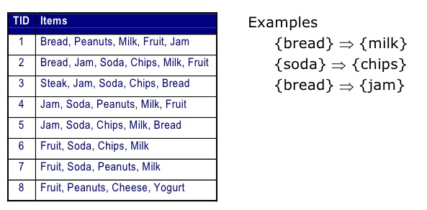
What is Association Rule Mining?
Given a set of transactions, find rules that will predict the occurrence of an item based on the occurrences of other items in the transaction

Slide 5
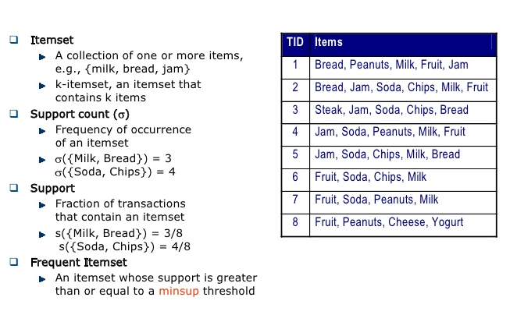
Association Rule Mining: Finding Frequent Item Sets

Slide 6
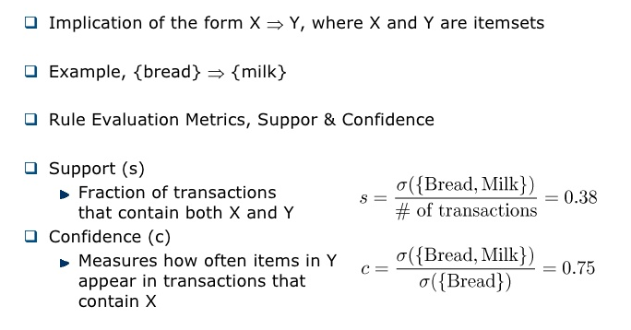
Association Rule Mining: Finding Frequent Item Sets

Slide 7
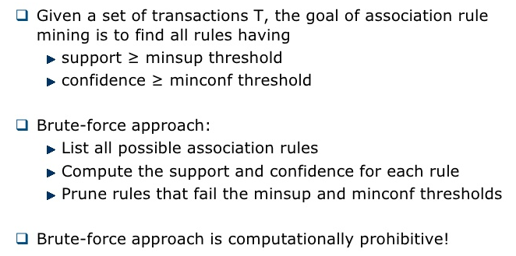
Association Rule Mining: Finding Frequent Item Sets
Goal

Slide 8
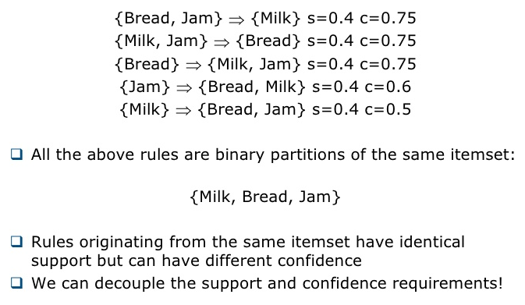
Association Rule Mining

Slide 9
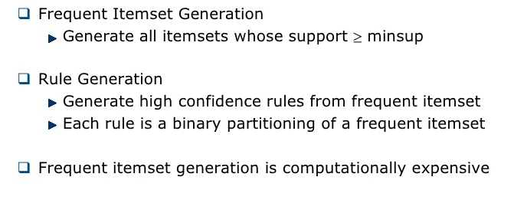
Association Rule Mining
Two Step Approach

Slide 10
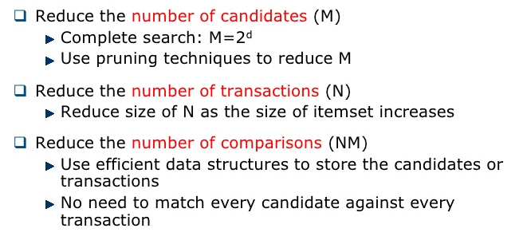
Association Rule Mining
Frequent Itemset Generation Strategies

Slide 11
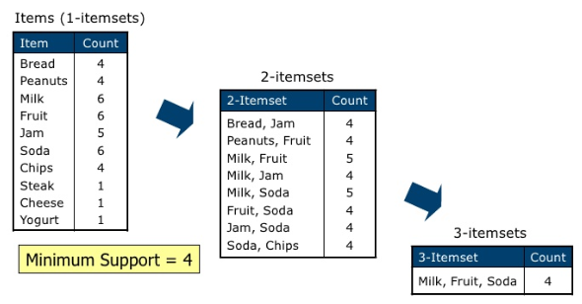
Association Rule Mining: Apriori Algorithm
Apriori principle
If an itemset is frequent, then all its subset must also be frequent

Slide 12
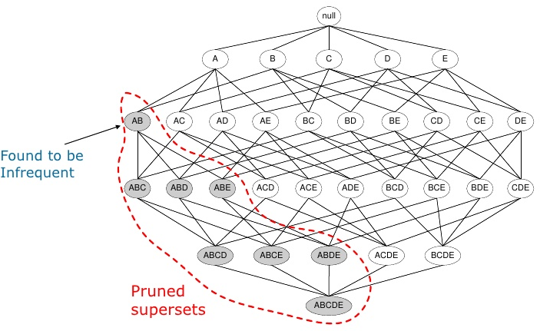
Association Rule Mining: Apriori Algorithm
Apriori principle: Useful in pruning supersets

Slide 13
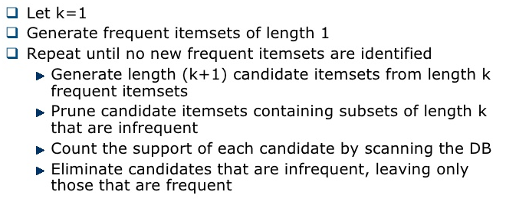
Association Rule Mining: Apriori Algorithm
Apriori Algorithm

Slide 14
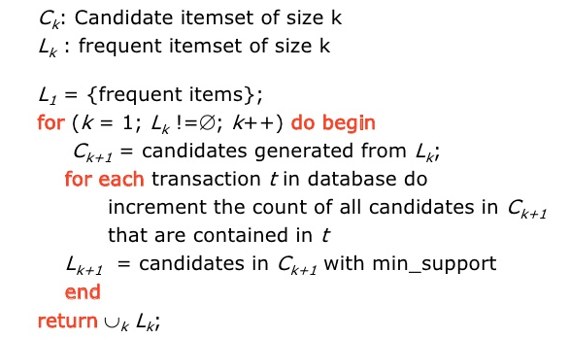
Association Rule Mining: Apriori Algorithm
The Apriori Algorithm

Slide 15
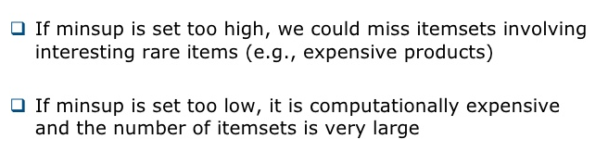
Association Rule Mining: Apriori Algorithm
Challenge: How to setup minsup?

Slide 16

Evaluation of Candidate Rules: Confidence
Frequent itemsets can form candidate rules
Confidence measures the certainty of a rule
Minimum confidence – predefined threshold
Problem with confidence
Given a rule X->Y, confidence considers only the antecedent (X) and the co-occurrence of X and Y
Cannot tell if a rule contains true implication

Slide 17

Evaluation of Candidate Rules: Lift
Lift measures how much more often X and Y occur together than expected if they are statistically independent
Lift = 1 if X and Y are statistically independent
Lift > 1 indicates the degree of usefulness of the rule
Example – in 1000 transactions,
If {milk, eggs} appears in 300, {milk} in 500, and {eggs} in 400, then Lift(milk->eggs) = 0.3/(0.5*0.4) = 1.5
If {milk, bread} appears in 400, {milk} in 500, and {bread} in 400, then Lift(milk->bread) = 0.4/(0.5*0.4) = 2.0

Slide 18
Evaluation of Candidate Rules: Leverage
Leverage measures the difference in the probability of X and Y appearing together compared to statistical independence
Leverage = 0 if X and Y are statistically independent
Leverage > 0 indicates degree of usefulness of rule
Example – in 1000 transactions,
If {milk, eggs} appears in 300, {milk} in 500, and {eggs} in 400, then Leverage(milk->eggs) = 0.3 - 0.5*0.4 = 0.1
If {milk, bread} appears in 400, {milk} in 500, and {bread} in 400, then Leverage (milk->bread) = 0.4 - 0.5*0.4 = 0.2

Slide 19
Validation and Testing
The frequent and high confidence itemsets are found by pre-specified minimum support and minimum confidence levels
Measures like lift and/or leverage then ensure that interesting rules are identified rather than coincidental ones
However, some of the remaining rules may be considered subjectively uninteresting because they don’t yield unexpected profitable actions
E.g., rules like {paper} -> {pencil} are not interesting/meaningful
Incorporating subjective knowledge requires domain experts
Good rules provide valuable insights for institutions to improve their business operations

